Slide 1
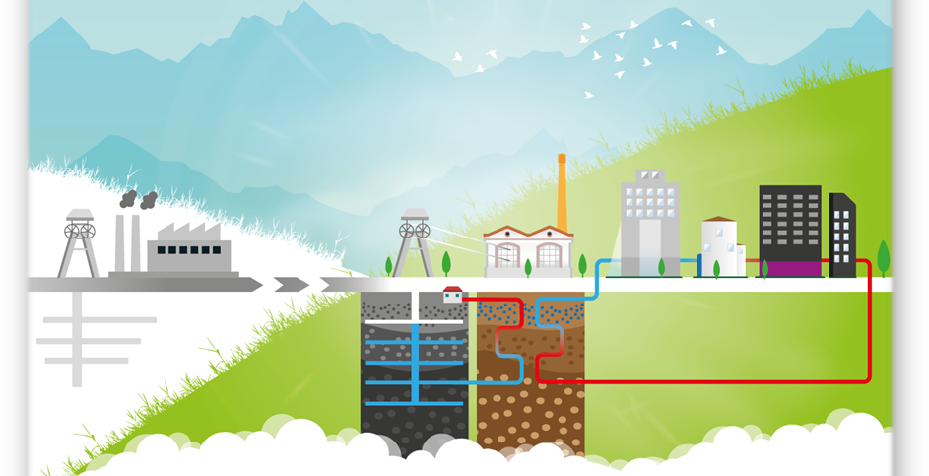
Heat pumps as a way to harness mine water heat
Noel Canto Toimil
Head of Department of Innovation of HUNOSA
noelcanto@hunosa.es

Slide 2


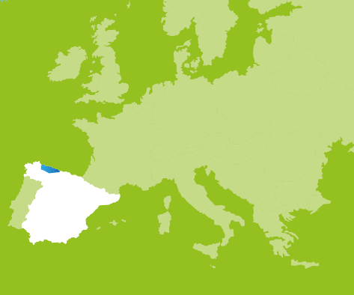
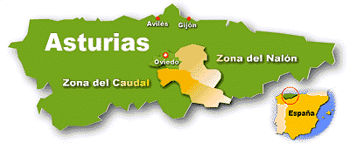
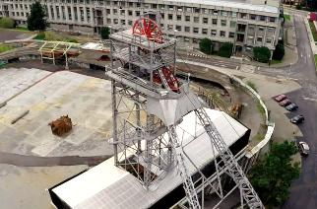
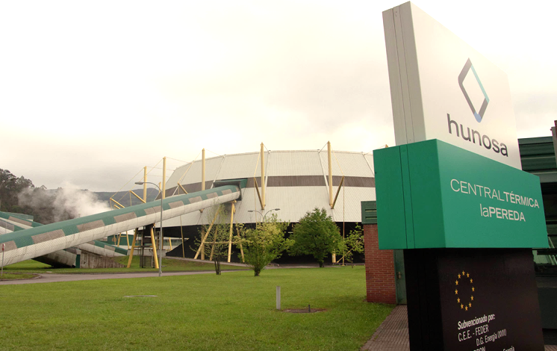

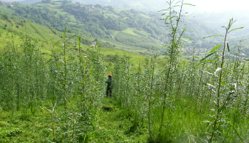
History
HUNOSA. Founded in 1967
Integration of coal mining private companies
Coal extraction: underground and open pit
More than 70 collieries and more than 2.000 mountain mines
Diversification activities
GEO
THERMAL
ECO
COMBUSTION
Geotermal energy from mine water
Biomass
Adaptation of La Pereda Power Plant for new fuels
Other renewable energies: photovoltaic, hydrogen…
BIO
MASS

Slide 3
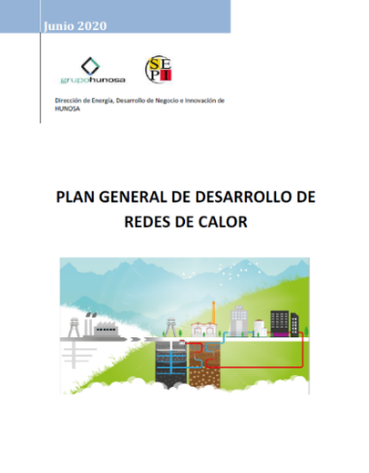
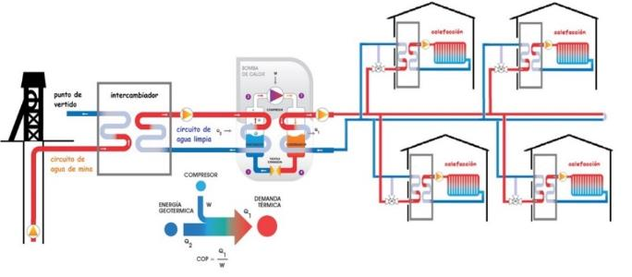
Geothermal energy. Our facilities
Geothermal facilities linked to Barredo Colliery
Barredo First facilities, in Mieres (1st phase). Heating and cooling
(in operation since 2014 - 2016):
  Hospital of Mieres
  Research Building of the University of Oviedo - Campus of Mieres
  Headquarters of Asturian Energy Foundation
Barredo District Heating, in Mieres (2nd phase). Heating and domestic hot water
(in operation since 2020):
  Dwelings: Blocks of apartments
  Secondary School
  Main building of the University of Oviedo – Campus Mieres.
Plan for the development of district heating systems
Geothermal facilities linked to El Fondón Colliery
Langreo District Heating (1st phase). Heating and domestic hot water
(in operation since 2022)
  Residential building
  Public Health Centre
  Hotel and Geriatric Centre (elderly residence)
  Sport Centre

Slide 4
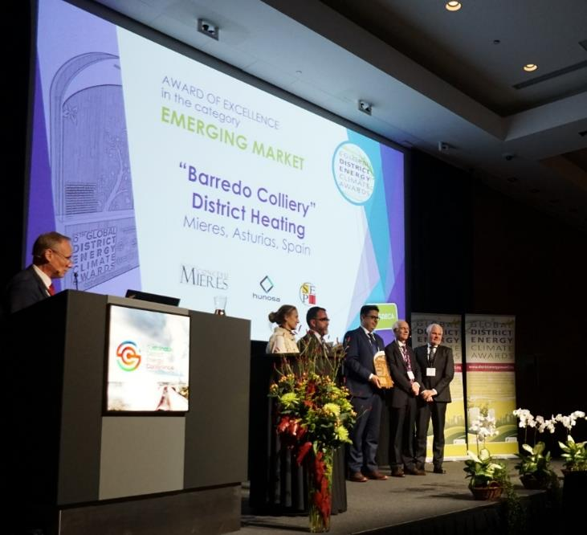






AWARD OF EXCELLENCE in the category of EMERGING MARKET
International Energy Agency - 6th Global District Energy Climate Awards. 2019
Participation in European Commission funded projects:
GREENJOBS (2022-2025)
POTENTIALS (2021-2023)
REWARDHEAT (2019-2023)

Slide 5
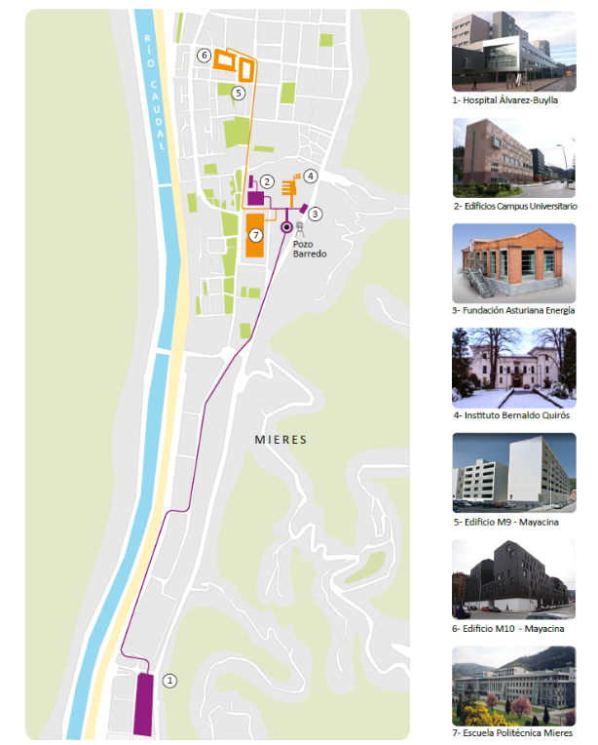
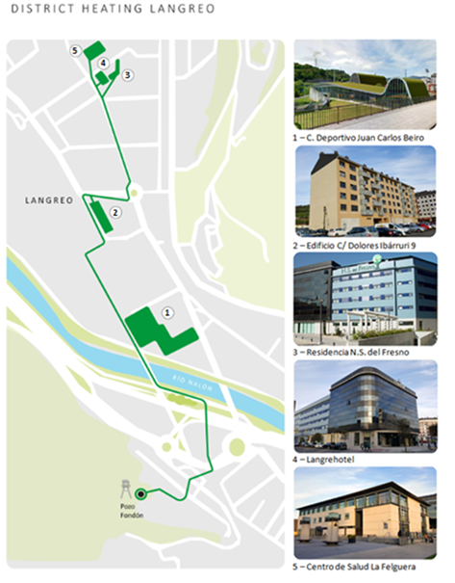
Geothermal energy. Our facilities
First and second phase.
Barredo Colliery (Mieres)
First phase.
El Fondón Colliery (Langreo)
N
N
500 m
250 m

Slide 6

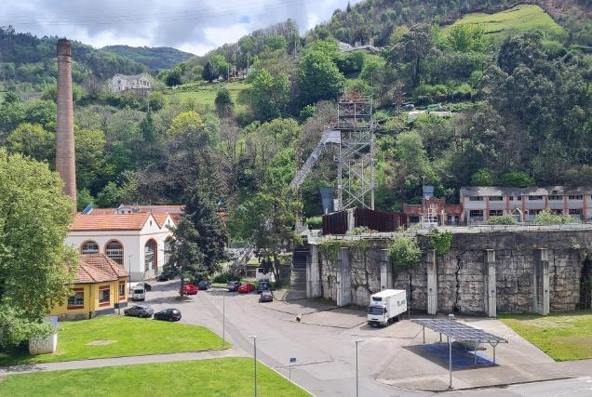
Geothermal energy. First phase. Barredo Colliery
Investment (€)
1.452.156,94
N
Data referred to 2021
Energy supplied:
  Heating: 5.058 MWh
  Cooling: 2.063 MWh
Reduction of CO₂ emissions: 1.567 t
500 m

Slide 7
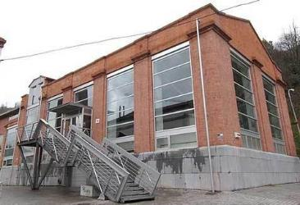
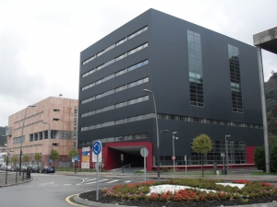
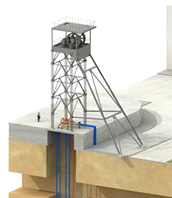

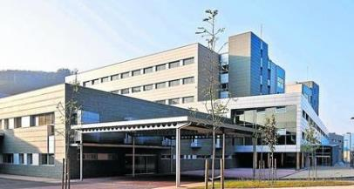
Geothermal energy. First phase. Barredo Colliery
  Research Building of the University of Oviedo
  (Campus of Mieres)
  Headquarters of Energy Asturian Foundation
To the river
18 ºC
To the river
18 ºC
HP 1
HP 2
HP 1
To the river
18 ºC
  Hospital of Mieres
15 ºC
23 ºC
20 ºC
23 ºC
23 ºC
HP 1
HP 2
HP 3
Sefety water level: 35 m
85 m – 100 m depth (1,2,4)
130 m depth (3)
4 pumps:
75 kW - 215 m3/h each
1 2 4
3

Slide 8
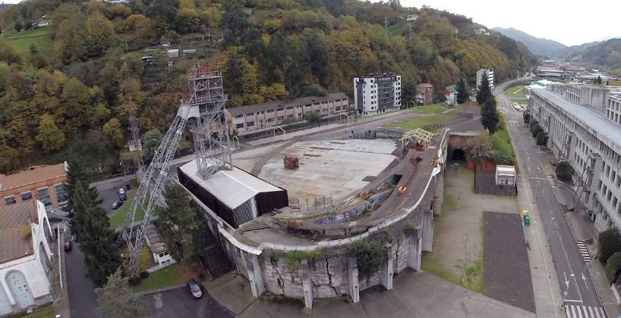

Geothermal energy. Second phase: Barredo District Heating
Investment (€)
1.421.541
503.125 €
N
Data referred to 2021
Energy supplied:
  Heating + domestic hot water: 1.789 MWh
Reduction of CO₂ emissions: 451 t
500 m

Slide 9
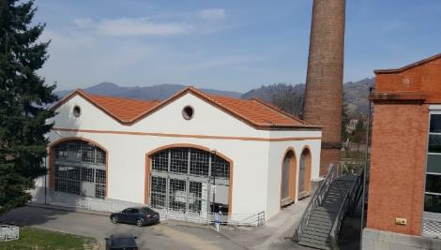
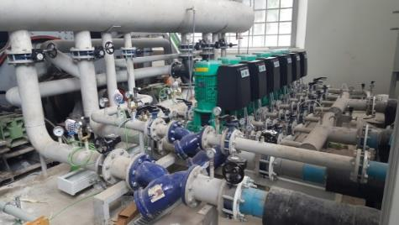
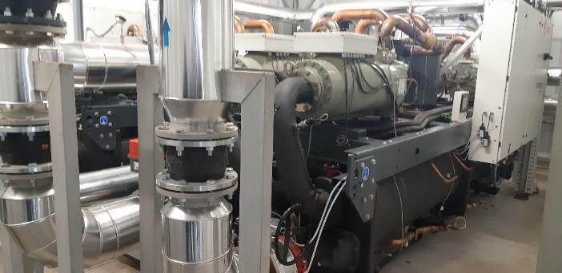
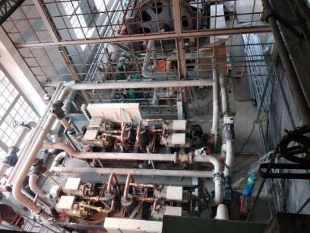
Geothermal energy. Second phase: Barredo District Heating
Tª = 75 ºC
Secondary
School
Tª = 80 ºC
Main building
Univ. Oviedo
Barredo District Heating generation room
Residential
building
M9
Condenser circuit
Tª = 50 ºC
Residential
building
M10
80ºC
72.5ºC
65ºC
HP 1 C
HP 2 C
20ºC
17.5ºC
15ºC
Tª = 40 ºC
Barredo District Heating pumping system
HP 1 E
HP 2 E
Tª = 65 ºC
To the river
18 ºC
Tª = 60 ºC
Evaporator circuit
23 ºC
Barredo District Heating heat pumps
Sefety water level: 37 m
2 pumps:
90 kW - 330 m3/h each
85 m – 95 m depth
5
6
Barredo District Heating heat pumps

Slide 10
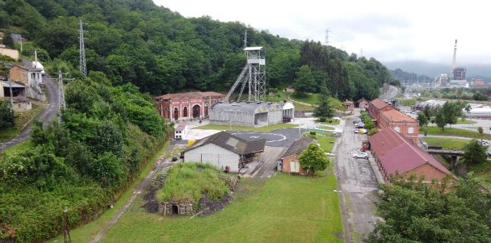
Geothermal energy. Langreo District Heating. El Fondón Colliery
Investment (€)
2.235.359,82
1.136.215 €
N
Estimations for 2022
Energy supplied:
  Heating + domestic hot water: 3.488 MWh
Reduction of CO₂ emissions: 887 t
250 m

Slide 11
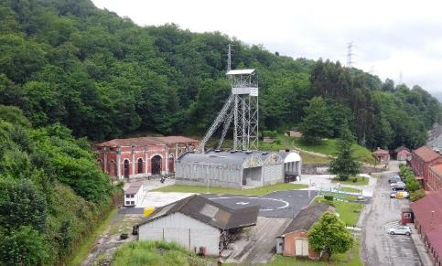
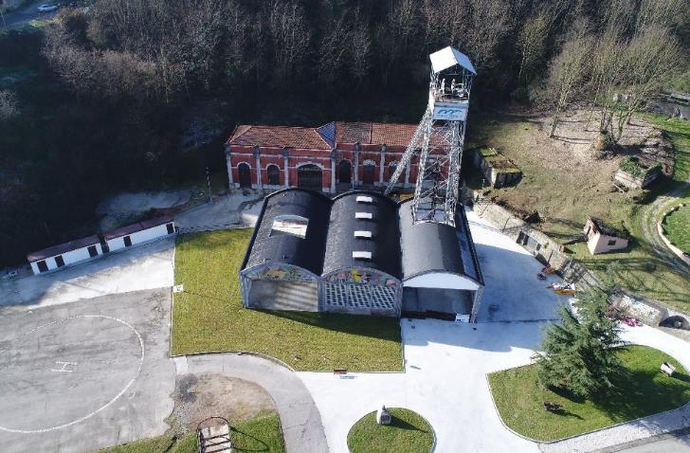
Geothermal energy. Langreo District Heating. El Fondón Colliery
Tª = 75 ºC
Different
facilities
Condenser circuit
75ºC
70ºC
65ºC
HP 1 C
HP 2 C
20ºC
17.5ºC
15ºC
Tª = 65 ºC
HP 1 E
HP 2 E
To the river
18 ºC
Evaporator circuit
23 ºC
Sefety water level: 43 m
4 pumps:
30 kW - 180 m³/h each
1
95 m – 110 m depth
2
3
4

Slide 12
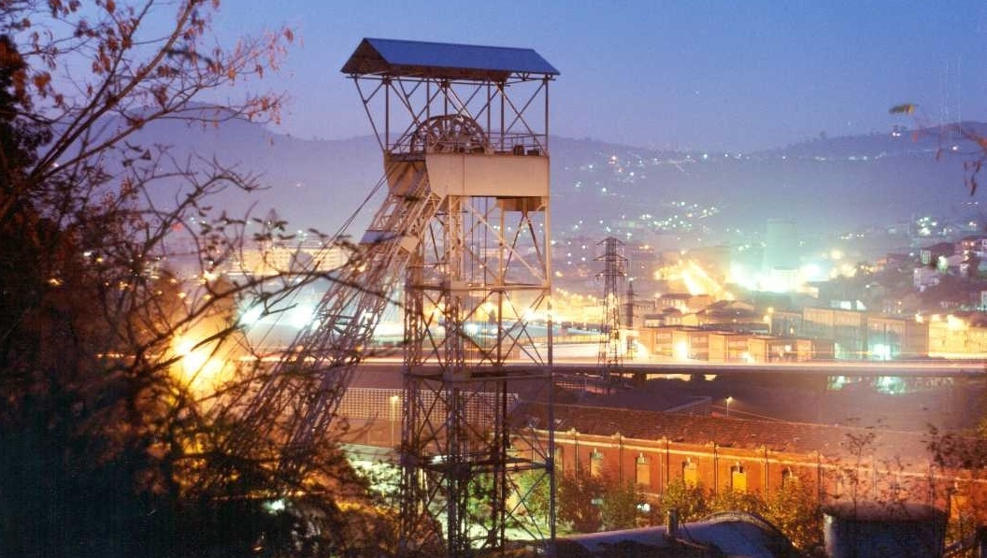

Thank you very much for your attention

