Slide 1
Synergistic potentials of end-of-life coal mines and coal-fired power plants, along with closely related neighbouring industries: update and re-adoption of territorial just transition plans
Deliverable 4.2
Social Impact Assessment

Slide 2
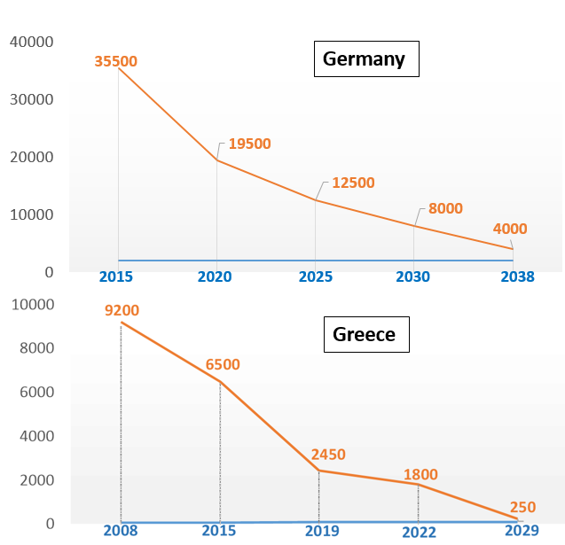
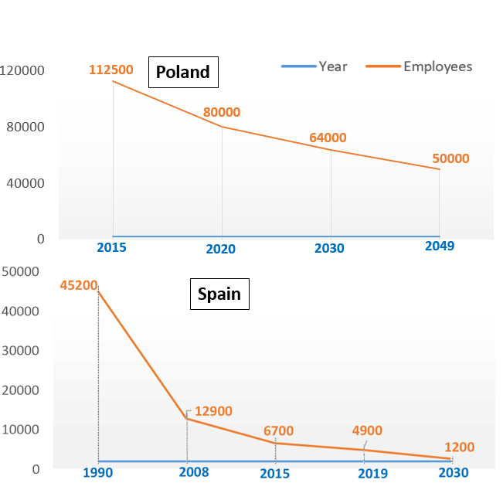
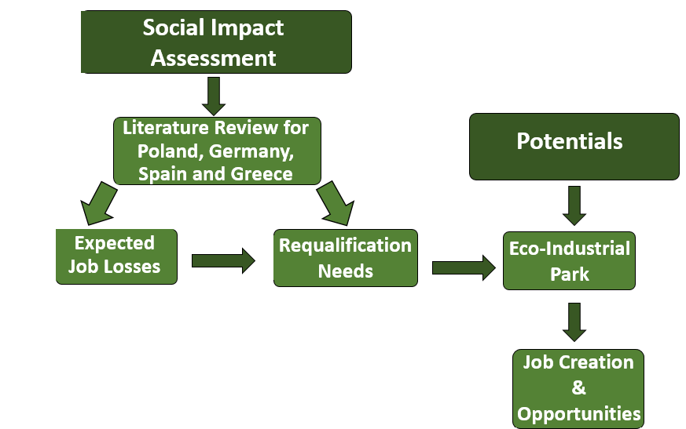
2. Job Losses – Coal Sector
1. Social Impact Assessment Scheme-Methodology
Data source: Dias et al. (2018) EU coal regions: opportunities and challenges ahead, JRC Science for Policy Report, Publications Office of the European Union, Luxembourg
Methodology of social impact study: Determination of the expected job losses and expected requalification skills focusing on the scenario of Eco-Industrial Park for the regions in transition
Job losses: By the year of the end of coal phase in each country, a large number of employees is expected to lose their jobs.
Employees of the coal mining & energy production sectors → for Renewable Energy Source jobs.
3. Eco-Industrial Parks & Requalification Needs
Notes:
Poland, Germany, Spain and Greece are amongst the top 10 countries with the highest number of direct jobs in the coal sector. Due to the high number of employees in the coal sector, these countries are considered to be vulnerable and at risk.
Source: Dias, A.; Kanellopoulos, P., K.; Medarac, H.; Kapetaki, Z.; Miranda-Barbosa, E.; Shortall, R.; … Tzimas, E. (2018) EU coal regions: opportunities and challenges ahead, JRC Science for Policy Report, Publications Office of the European Union, Luxembourg, available at https://op.europa.eu/en/publication-detail/-/publication/de175603-896a-11e8-ac6a-01aa75ed71a1/language-en

Slide 3
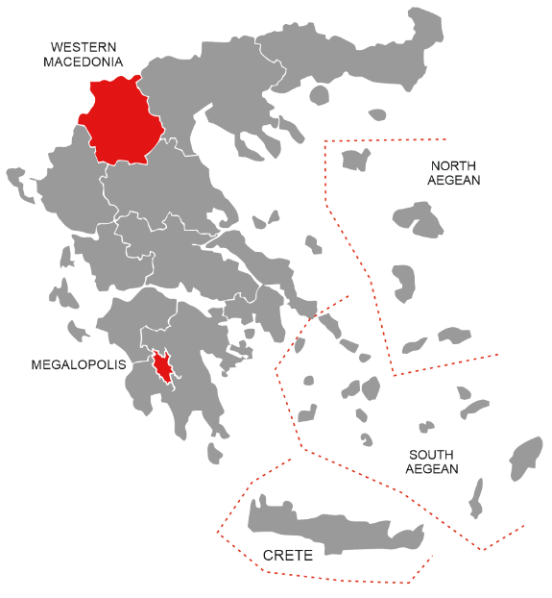
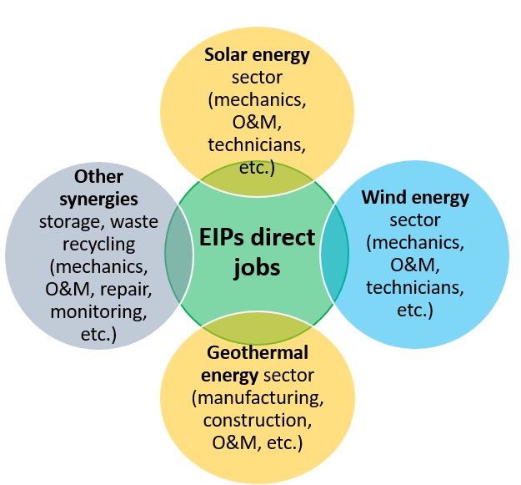
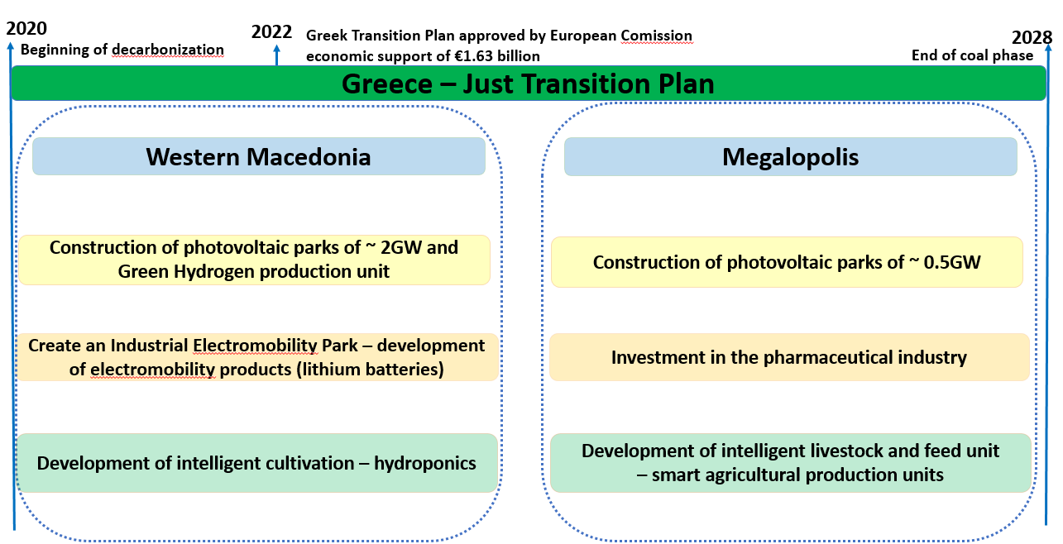
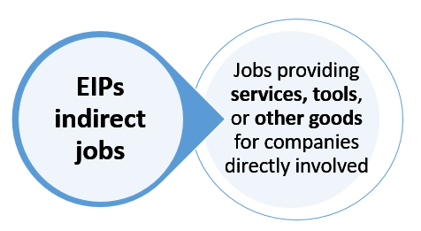
4. Eco-Industrial Parks & Job Opportunities
5. Just Transition in Greece – Areas of Interest
The transition in Greece is focused on de-carbonisation of the Western Macedonia and Megalopolis regions
In September 2020, the Greek government submitted its Just Transition Development Plan
The JTDP was approved by the European Commission in June 2022, with a total economic support of €1.63 billion. The overall goal of the transition is to close all the active lignite plants in the country by 2028
*O&M: Operation & Maintenance

