Slide 1
From POTENTIALS to GreenJOBS: how accompanying measures project ideas can support development of green business models for coal regions
prof. Alicja Krzemień
Head of Laboratory of Risk Assessment and Industrial Safety
23.05.2023

Slide 2



Synergistic POTENTIALS of end-of-life coal mines and coal-fired power plants, along with closely related neighbouring industries: update and re-adoption of territorial just transition plans.
EU Research Fund for Coal and Steel (RFCS) Grant Agreement No 101034042
www.potentialsproject.eu
Potential of end-of-life coal mines and coal-fired power plants
Opportunities to develop new business models
New economic activities and jobs in Coal Regions in Transition
Notes:
There are two projects funded by the Research Fund for Coal and Steel (RFCS) linked to the objectives of the European Green Deal, aiming to achieve in the EU no net emissions of greenhouse gases in 2050 and with economic growth decoupled from resource use.
First, the POTENTIALS project focuses on the repurposing of end-of-life underground coal mines and coal-fired power plants, identifying and assessing the development of new business models relying on renewable energy and contributing to the circular economy.
Second, the GreenJOBS project develops some of these business models by leveraging five competitive advantages of end-of-life underground coal mines.

Slide 3
ACTIONS
Virtual power plant
Green hydrogen plant
Eco-industrial park
MICRO-ACTIONS
Cultural heritage and sports/recreation areas
Floating PV panels at flooded open-pit coal mines
Fisheries in flooded open-pit mines
Combined-cycle gas turbine power plant (natural gas)
Mine gas utilization for gas-powered CHP power units
Small modular reactors
Biofules combustion Energy plants
Moltens salt plant
Agrophotovoltaics at former open-pit coal mine areas
Ancillary services provided by batteries
Recovery of resources from coal mining weste heaps
Usage of CH₄ from degasification units in closed mines
Circular mining technologies for pumped water material recovery
Forest retoration at former open-pit coal mines
Large-scale IT infrastructure – power plant
Geothermal energy
Storage of energy using weights
Storage of energy using dense fluids
Storage of energy in mine shaft
Notes:
ACTIONS selected business models that rely on renewable energy, circular economy or scale energy storage.
CRITERIA refers to evaluation criteria emanating from the goal and objectives of the study.
POLICIES directly related to one of the Commission priorities for 2019-2024: the European Green Deal.

Slide 4
ENERGY SECURITY
RENEWABLE RESOURCES (GREENING)
LOW INVESTMENT BARRIERS
BENEFITS
REGIONAL DEVELOPMENT
ENVIRONMENT
JOB CREATION
PEOPLE (no person and no place left behind)
GROWTH
CLIMATE
criteria
European Green Deal Policies
Notes:
ACTIONS selected business models that rely on renewable energy, circular economy or scale energy storage.
CRITERIA refers to evaluation criteria emanating from the goal and objectives of the study.
POLICIES directly related to one of the Commission priorities for 2019-2024: the European Green Deal.

Slide 5

POTENTIALS Project
Evaluation of actions and micro-actions related to policies.

Slide 6
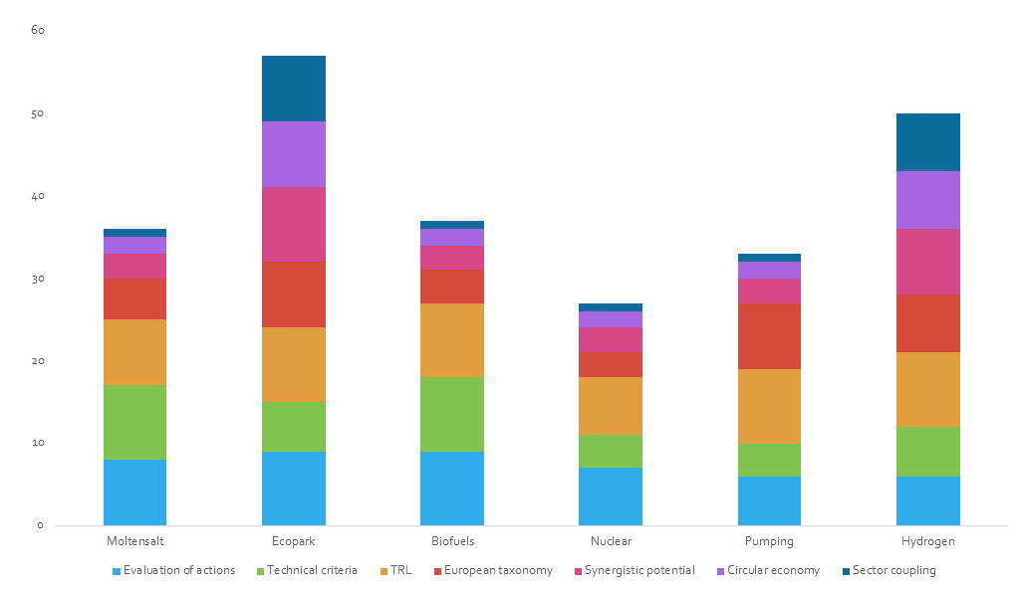
POTENTIALS Project - business model choice (actions)
Evaluation of actions
Technical criteria
TRL
European taxonomy
Synergistic potential
Circular economy
Sector coupling
ECO-INDUSTRIAL PARK
HYDROGEN

Slide 7
POTENTIALS Project
ECO-INDUSTRIAL PARK SCENARIO
Eco-industrial parks (with virtual power plant) as an integrated alternative to be developed within coupled end-of-life coal mine sites and coal-fired power plants along with surrounding residential/industrial areas for sustainable renewable energy generation (geothermal and photovoltaic/wind), storage technologies, circular economy contributions and synergies for reducing waste and pollution by promoting short distance transport and optimising the park’s material, resource, and energy flows, producing the goods needed for the industrial transition in Europe and cooperating to its achievement.
Eco-industrial parks should be based on district networks that allow multiple energy sources to be connected to various energy consumption points, helping to increase photovoltaic deployment by transforming heat and power energy customers into prosumers or customers with excess electricity from solar panels on their roofs. Eco-industrial parks should be supported by pursuing financial privileges and other benefits to boost and diversify the area’s economy, attracting external investment: tax exemptions for industries, access to preferential credits from National authorities, European Investment Bank, and others.

Slide 8
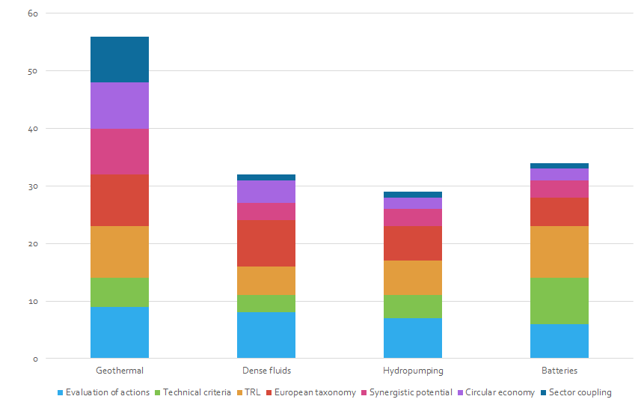
POTENTIALS Project - business model choice (micro-actions)
Evaluation of actions
Technical criteria
TRL
European taxonomy
Synergistic potential
Circular economy
Sector coupling
GEOTHERMAL
BATTERIES

Slide 9
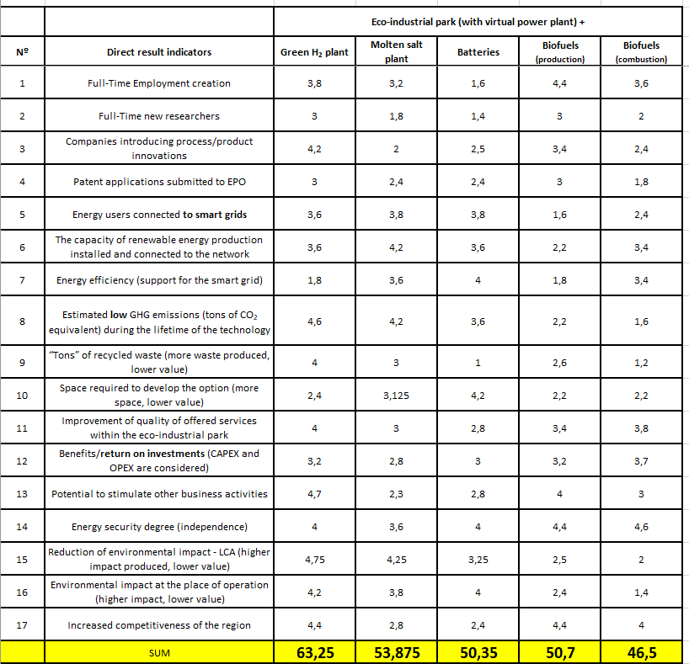
POTENTIALS Project
SCENARIO (MULTI-ACTION)
Eco-industrial park (with virtual power plant)
+
Green H₂ plant
Molten salt plant
Batteries
Biofuels production
Biofuels combustion

Slide 10
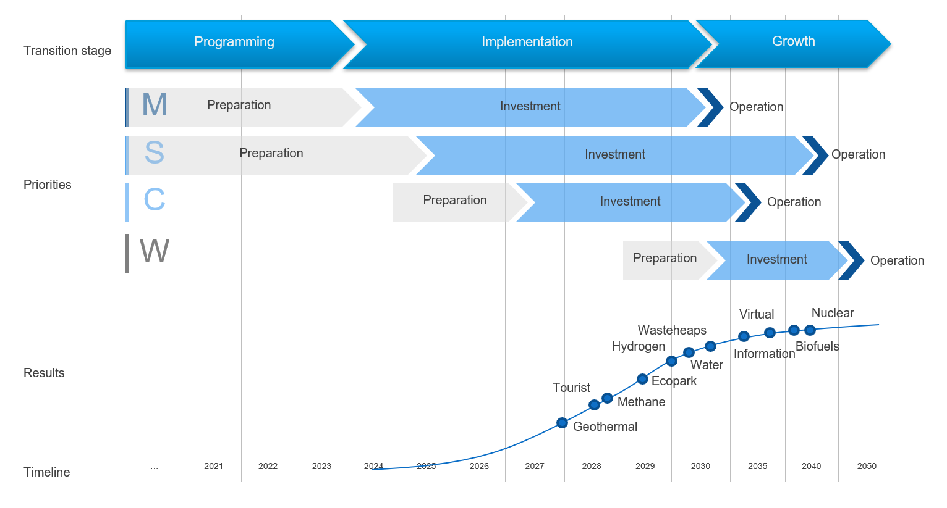
Road map for update of JTP for Silesian Voivodship

Slide 11


Leveraging the competitive advantages of end-of-life underground coal mines to maximise the creation of green and quality jobs.
EU Research Fund for Coal and Steel (RFCS) Grant Agreement No 101057789
www.greenjobsproject.eu
Notes:
There are two projects funded by the Research Fund for Coal and Steel (RFCS) linked to the objectives of the European Green Deal, aiming to achieve in the EU no net emissions of greenhouse gases in 2050 and with economic growth decoupled from resource use.
First, the POTENTIALS project focuses on the repurposing of end-of-life underground coal mines and coal-fired power plants, identifying and assessing the development of new business models relying on renewable energy and contributing to the circular economy.
Second, the GreenJOBS project develops some of these business models by leveraging five competitive advantages of end-of-life underground coal mines.

Slide 12

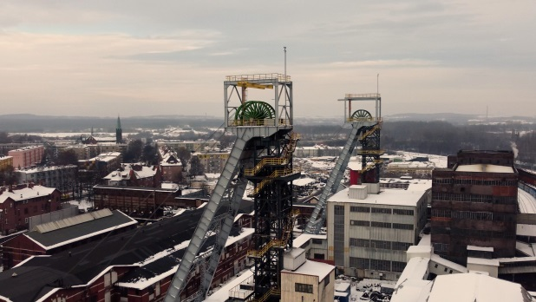
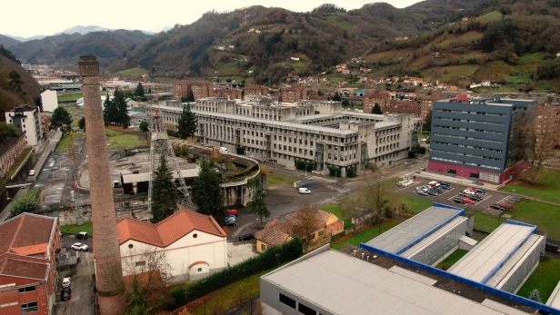
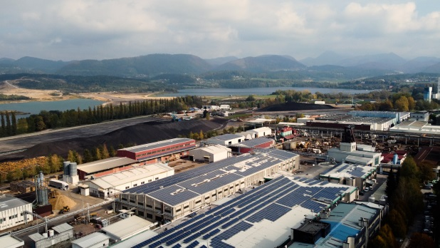
Bobrek-Piekary Coal Mine, POLAND
GreenJOBS Project
Aller-Barredo-Figaredo, SPAIN
Premogovnik Velenje, SLOVENIA

Slide 13

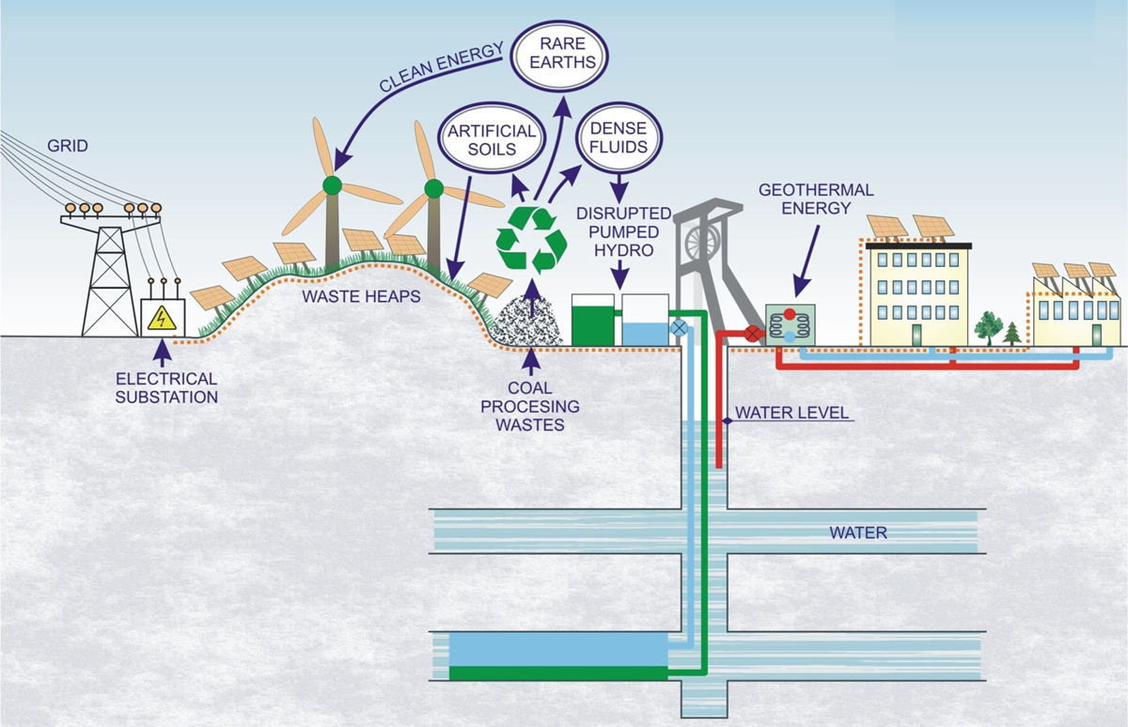
GreenJOBS Project
Business model 1: Virtual Power Plant where energy is sold to the grid.

Slide 14
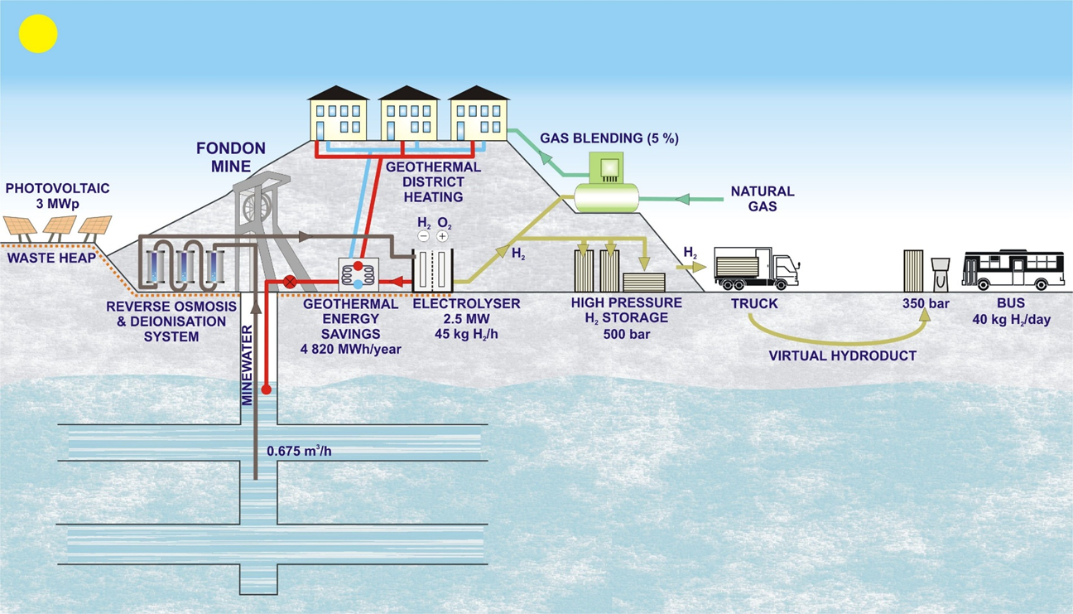
GreenJOBS Project
Business model 2: Green hydrogen plant.

Slide 15
THANK YOU FOR ATTENTION
Alicja Krzemień
Head of Laboratory of Risk Assessment and Industrial Safety
Department of Extraction Technologies, Rockburst and Risk Assessment
Plac Gwarków 1
40-166 Katowice
Poland
phone: +48 32 259 2556
akrzemien@gig.eu

